Slide 1

F L Y I N G C A R (ROADABLE AIRCRAFT)
PRESENTED BY-
ROYSTON V. D’SOUZA
SUNIL K. MISHRA
SREEJITH. P
SUJEET. P

Slide 2
CONTENTS
INTRODUCTION
TECHNOLOGY
FLYING CARS
TERRAFUGIA TRANSITION
IMPACT IN INDIA
OPPORTUNITIES
THREATS
REFERENCES

Slide 3
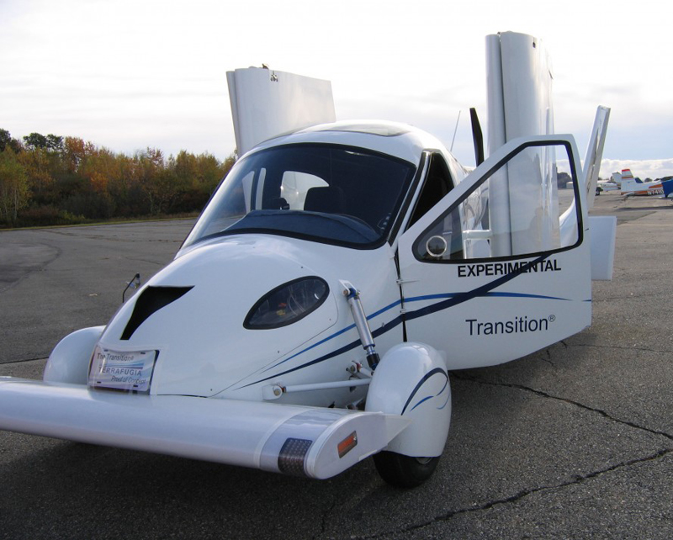
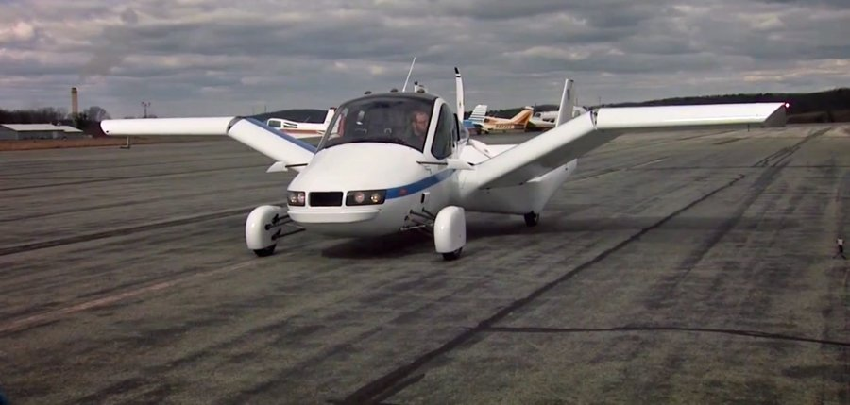
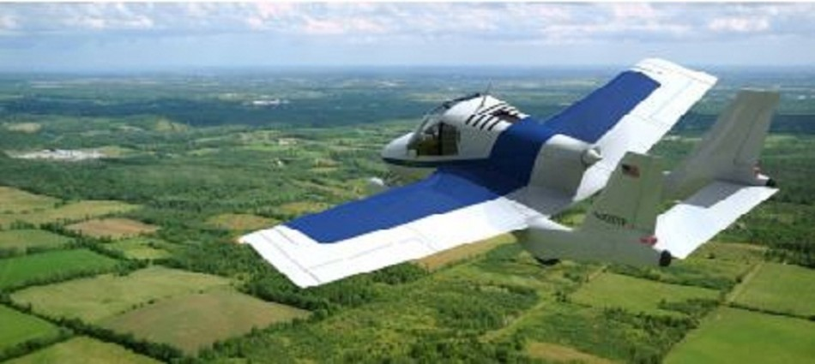
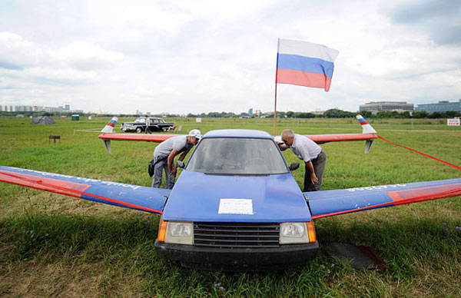

Slide 4
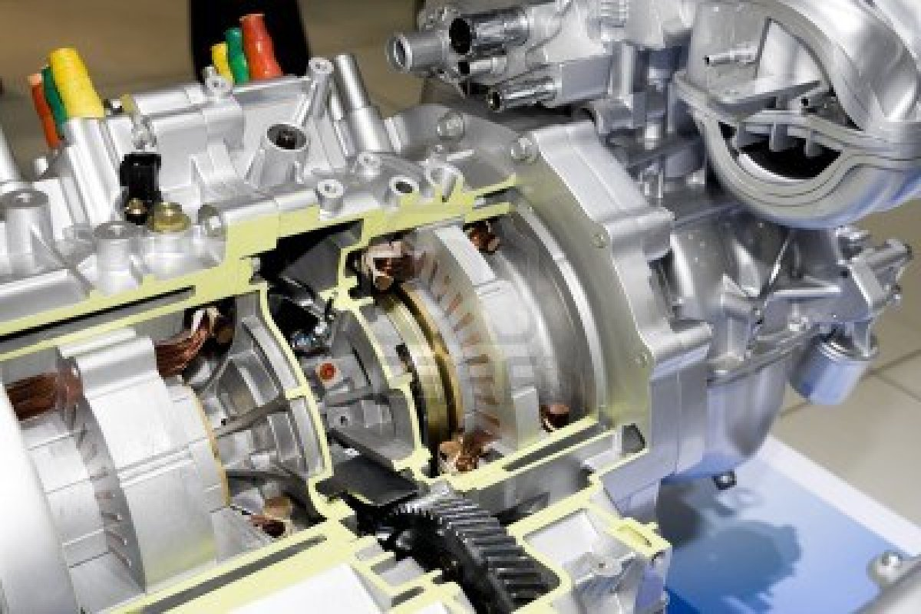
INTRODUCTION
TECHNOLOGY
CONCENTRATING IN FUTURE
SCIENCE FINCTION

Slide 5
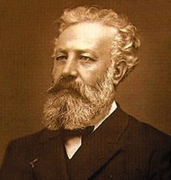
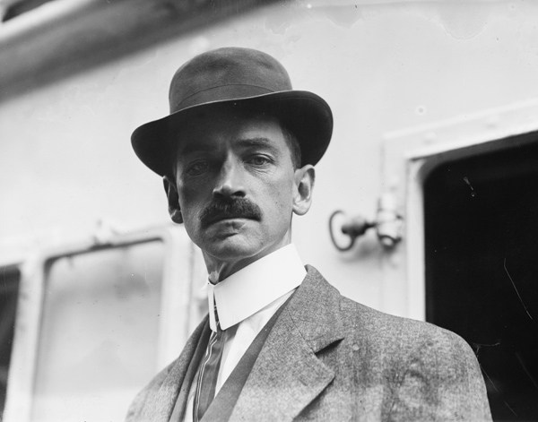
CONTINUED…
FLYING CARS
1904- JULES VERNE
MASTER OF THE WORLD
1917- GLENN CURTISS
FATHER OF FLYING CARS , HOPPING CAR
1928- HENRY FORD
FAILED ATTEMPT

Slide 6
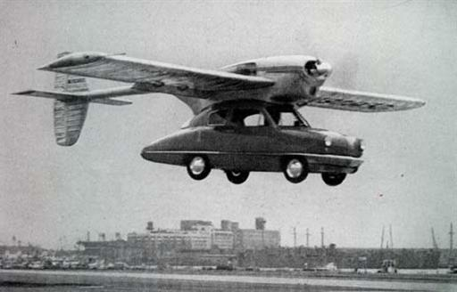

Slide 7
CONTINUED…
TERRAFUGIA TRANSITION
LIGHT SPORT ROADABLE AIRCRAFT
U.S BASED COMPANY TERRAFUGIA
TWO SEATER
70 MPH (110 KMPH) ON ROAD
93 KNTS (107 MPH, 172 KMPH) IN AIR
MILAGE – 450 MILES
INDIA, BRAZIL, CHINA

Slide 8
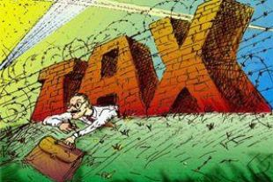
IMPACT IN INDIA
POSITIVE IMPACTS
DRASTIC CHANGE(economy)
MODERNIZATION IN TECHNOLOGY
REDUCE LAND TRAFFIC PROBLEM
PRIVATE FLYING MACHINE

Slide 9
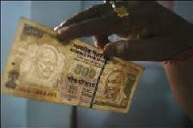

CONTINUED…
NEGATIVE IMPACTS
ENVIRONMENTAL ISSUE
NOT ECO-FRIENDLY
PRICING
LANDING PROBLEM

Slide 10

OPPORTUNITY
WILLIGNESS TO ACCEPT CHANGES
NOW THE TIME OF TECHNOLOGICAL REVOLUTION
INDIA IS A PROMISING MARKET

Slide 11
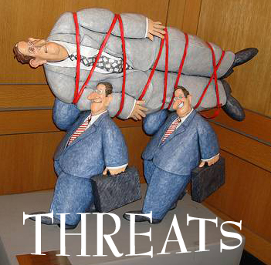
THREATS
ENVIRONMENT
( exploitation of resources , need spaces , pollution )
HAZARDS OF BAD DRIVING / FLYING
NOISE ISSUE
SAFETY OF PEOPLE ( engine failure)
EFFECTS AUTOMOBILE

Slide 12
REFERENCES
http://www.thehindu.com/business/Industry/article2600671.ece
http://environment.about.com/od/greenlivingdesign/a/fly_vs_drive.htm
http://illumin.usc.edu/printer/203/flying-cars-and-the-future-of-civil-transportation/
http://environment.about.com/od/greenlivingdesign/a/fly_vs_drive.htm
http://blogs.wsj.com/indiarealtime/2011/05/18/the-flying-car-soon-to-come-to-india/
http://www.flyingcarassociation.com/frequently-asked-questions/

Slide 13


